Slide 1
Conceptual framework of costs, benefits and risks of Agro-climate information
interventions in Dien Bien Province, Vietnam
Benefits of interventions
Agro-climate interventions
Implementation
Costs of interventions
Risk
Not accurate- forecasts
Dis-adoption
Hydro-met stations
Forecasts
Translation forecasts into agro-advisories
Dissemination (SMS/loud speaker)
Use
Advisories
Gender
M&E
Reduced inputs, losses
Increased yields
Reduced water pollution
and
Fish death
Improved income from gender equality
Staff’s advice,
Farmers’
Health expense
Total Costs
Discount rate
Total Benefits
Cost
Total and stakeholders’
NPV
Benefit
Risk
Discount rate

Slide 2
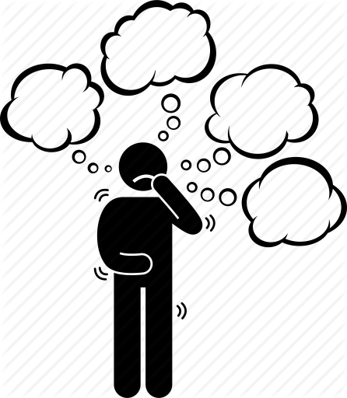
Which ACIS solutions that CARE should advocate Dien Bien People Committee to invest for implementation?
Less comprehensive?
Comprehensive?
Simplified?
More simplified?
Notes:
Business as usual
General trainings on agriculture production
Bulletin provision for disease prevention and control, not specific for weather conditions

Slide 3
Which ACIS solutions that CARE should advocate Dien Bien People Committee to invest for implementation?
No | Solution 1 | Solution 2 | Solution 3 | Solution 4
1 | Establish additional station in Muong Ang | Use the existing system to generate climate data | Use the existing system to generate climate data | Use the existing system to generate climate data
2 | Provide seasonal and weekly forecasts Monitor quality of forecasts | Provide seasonal and weekly forecasts Monitor quality of forecasts | Provide seasonal and weekly forecasts Monitor quality of forecasts | Provide seasonal and weekly forecasts Monitor quality of forecasts
3 | Set up district agro-climate technical coordination groups and operation | Set up district agro-climate technical coordination groups and operation | Set up district agro-climate technical coordination groups and operation | Set up district agro-climate technical coordination groups and operation
4 | Build capacity for agriculture staff: meteorology basic, translation into agro-advisories, bulletin edit | Build capacity for agriculture staff: meteorology basic, translation into agro-advisories, bulletin edit | Build capacity for agriculture staff: meteorology basic, translation into agro-advisories, bulletin edit | Build capacity for agriculture staff: meteorology basic, translation into agro-advisories, bulletin edit
5 | Set up SMS dissemination system Monitor, use data from SMS system | Set up SMS dissemination system Monitor, use data from SMS system | Dissemination via loudspeaker system + village meeting using existing system + SMS | Dissemination via loudspeaker + village meeting using existing system
6 | Engage Sub-Government Units in the implementation (People Committee, commune extension workers and village leader) | Engage Sub-Government Units in the implementation (People Committee, commune extension workers and village leader) | Engage Sub-Government Units in the implementation (People Committee, commune extension workers and village leader) | Engage Sub-Government Units in the implementation (People Committee, commune extension workers and village leader)
7 | Gender: Balance and SAA | Gender: Balance and SAA | Gender: Balance | Gender: Balance

Slide 4
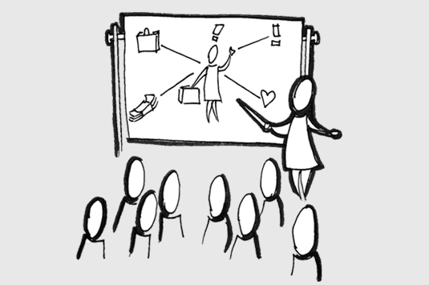
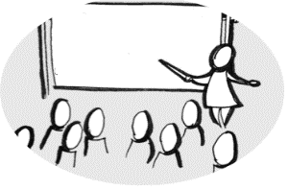



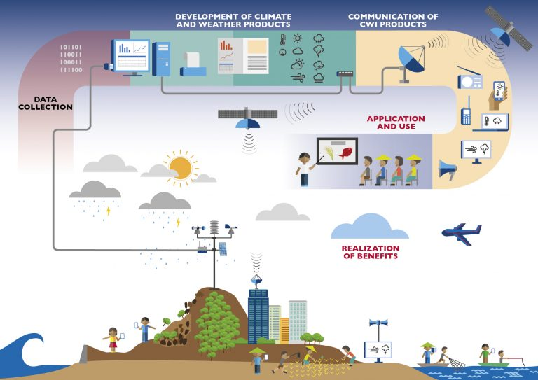


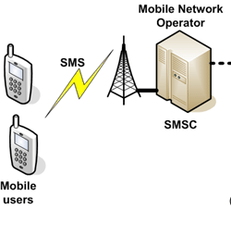


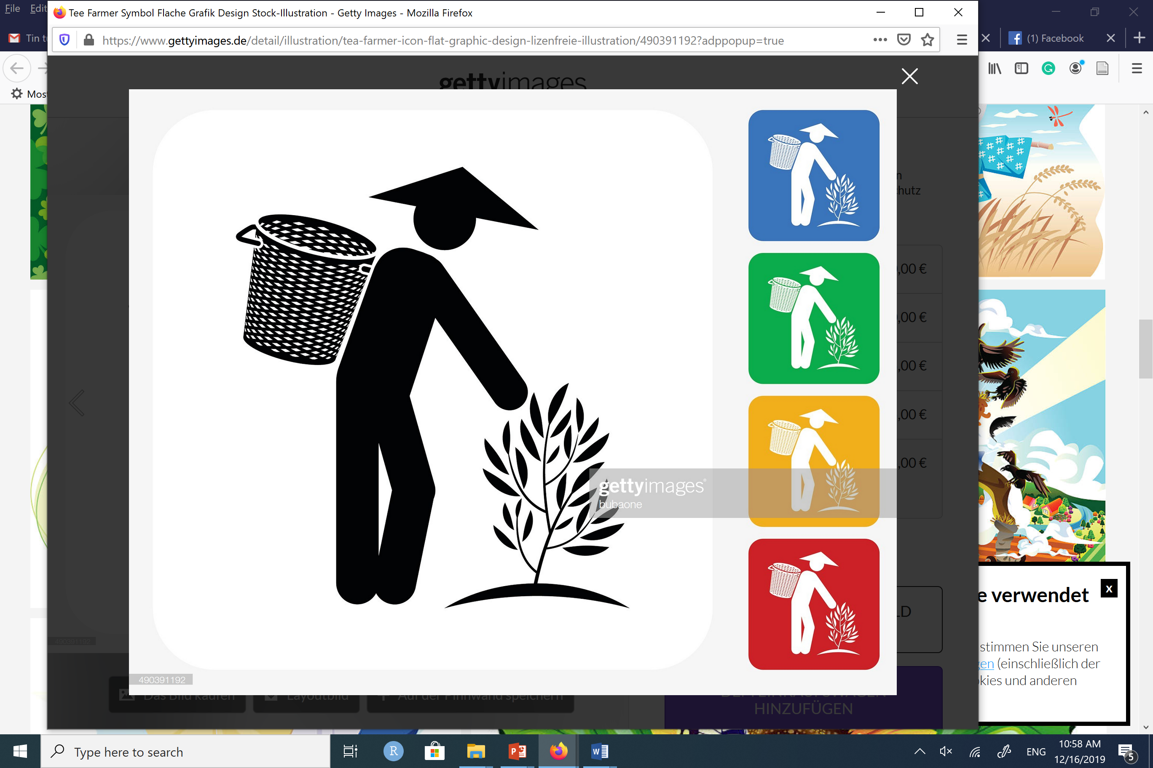




Which options to advocate for investment?
Option #1
Capacity building
Subscribers’ info
Advisories
Forecasts
SMS
Dien Bien
Feedbacks
SMS logs, feedbacks
Muong Ang
Forecasts
Monitoring
Translation into advisories
Use of information
Subscribers’ info., Feedbacks
Gender dialogue and sensitiveness
Subscribers’ info.
Sub-Gov Units, NGO engagement
Notes:
https://www.vectorstock.com/royalty-free-vector/business-meeting-sketch-vector-2850121
https://en.wikipedia.org/wiki/Global_temperature_record
http://www.ozekisms.com/index.php?owpn=368
https://www.gettyimages.de/detail/illustration/tea-farmer-icon-flat-graphic-design-lizenfreie-illustration/490391192?adppopup=true
https://www.google.com/search?q=rice+drawing&sxsrf=ACYBGNSEO1Ytn7WU0_oJATOGi5zV-ZbVbQ:1576491829330&source=lnms&tbm=isch&sa=X&ved=2ahUKEwjZ0unb-bnmAhVK2aQKHSRDDNQQ_AUoAXoECA0QAw&biw=1368&bih=748&dpr=2#imgrc=LXPize0mVFd3zM
https://www.google.com/search?q=temperature+graph&client=firefox-b-d&sxsrf=ACYBGNSTsCN0SIL0gK5HmwQFaJGKnnIysg:1576491556307&source=lnms&tbm=isch&sa=X&ved=2ahUKEwig1NHZ-LnmAhWD_KQKHU6ZBQUQ_AUoAXoECA0QAw&biw=1368&bih=748#imgrc=UuT-xAx6VaT0_M

Slide 5

Which options to advocate for investment? Who involves?
Option #1
Capacity building
{by Provincial Department of Agriculture and Rural Development}
Subscribers’ info
Advisories
Forecasts
SMS
Dien Bien
Feedbacks
SMS logs, feedbacks
Forecasts
Monitoring
{Mobile Network Operator}
Use of information
Muong Ang
Translation into advisories
{Women, men}
{District technical working group}
{District observation points}
{Provincial Met station}
Subscribers’ info., Feedbacks
Gender dialogue and sensitiveness
{Women Union, CCD}
{Department of Agriculture and Rural Development}
Subscribers’ info.
{District Agri. Extension Center}
Sub-Gov Units, NGO engagement
{Commune People Committee, extension workers, village heads, Women Union, CCD}
{Provincial People Committee}
{District People Committee}
Notes:
https://www.vectorstock.com/royalty-free-vector/business-meeting-sketch-vector-2850121
https://en.wikipedia.org/wiki/Global_temperature_record
http://www.ozekisms.com/index.php?owpn=368
https://www.gettyimages.de/detail/illustration/tea-farmer-icon-flat-graphic-design-lizenfreie-illustration/490391192?adppopup=true
https://www.google.com/search?q=rice+drawing&sxsrf=ACYBGNSEO1Ytn7WU0_oJATOGi5zV-ZbVbQ:1576491829330&source=lnms&tbm=isch&sa=X&ved=2ahUKEwjZ0unb-bnmAhVK2aQKHSRDDNQQ_AUoAXoECA0QAw&biw=1368&bih=748&dpr=2#imgrc=LXPize0mVFd3zM
https://www.google.com/search?q=temperature+graph&client=firefox-b-d&sxsrf=ACYBGNSTsCN0SIL0gK5HmwQFaJGKnnIysg:1576491556307&source=lnms&tbm=isch&sa=X&ved=2ahUKEwig1NHZ-LnmAhWD_KQKHU6ZBQUQ_AUoAXoECA0QAw&biw=1368&bih=748#imgrc=UuT-xAx6VaT0_M

Slide 6
Which options to advocate for investment?
Option #2
Capacity building
Tuan Giao
Subscribers’ info
Advisories
Forecasts
SMS
Dien Bien
Feedbacks
SMS logs, feedbacks
Forecasts
Monitoring
Translation into advisories
Use of information
Muong Ang
Subscribers’ info., Feedbacks
Gender dialogue and sensitiveness
Subscribers’ info.
Sub-Gov Units, NGO engagement
Notes:
https://www.vectorstock.com/royalty-free-vector/business-meeting-sketch-vector-2850121
https://en.wikipedia.org/wiki/Global_temperature_record
http://www.ozekisms.com/index.php?owpn=368
https://www.gettyimages.de/detail/illustration/tea-farmer-icon-flat-graphic-design-lizenfreie-illustration/490391192?adppopup=true
https://www.google.com/search?q=rice+drawing&sxsrf=ACYBGNSEO1Ytn7WU0_oJATOGi5zV-ZbVbQ:1576491829330&source=lnms&tbm=isch&sa=X&ved=2ahUKEwjZ0unb-bnmAhVK2aQKHSRDDNQQ_AUoAXoECA0QAw&biw=1368&bih=748&dpr=2#imgrc=LXPize0mVFd3zM
https://www.google.com/search?q=temperature+graph&client=firefox-b-d&sxsrf=ACYBGNSTsCN0SIL0gK5HmwQFaJGKnnIysg:1576491556307&source=lnms&tbm=isch&sa=X&ved=2ahUKEwig1NHZ-LnmAhWD_KQKHU6ZBQUQ_AUoAXoECA0QAw&biw=1368&bih=748#imgrc=UuT-xAx6VaT0_M

Slide 7
Which options to advocate for investment? Who involves?
Option #2
Capacity building
{by Provincial Department of Agriculture and Rural Development}
Tuan Giao
Subscribers’ info
Advisories
Forecasts
SMS
Dien Bien
Feedbacks
SMS logs, feedbacks
Forecasts
Monitoring
{Mobile Network Operator}
Use of information
Muong Ang
Translation into advisories
{Women, men}
{District technical working group}
{District observation points}
{Provincial Met station}
Subscribers’ info., Feedbacks
Gender dialogue and sensitiveness
{Women Union, CCD}
{Department of Agriculture and Rural Development}
Subscribers’ info.
{District Agri. Extension Center}
Sub-Gov Units, NGO engagement
{Commune People Committee, extension workers, village heads, Women Union, CCD}
{Provincial People Committee}
{District People Committee}
Notes:
https://www.vectorstock.com/royalty-free-vector/business-meeting-sketch-vector-2850121
https://en.wikipedia.org/wiki/Global_temperature_record
http://www.ozekisms.com/index.php?owpn=368
https://www.gettyimages.de/detail/illustration/tea-farmer-icon-flat-graphic-design-lizenfreie-illustration/490391192?adppopup=true
https://www.google.com/search?q=rice+drawing&sxsrf=ACYBGNSEO1Ytn7WU0_oJATOGi5zV-ZbVbQ:1576491829330&source=lnms&tbm=isch&sa=X&ved=2ahUKEwjZ0unb-bnmAhVK2aQKHSRDDNQQ_AUoAXoECA0QAw&biw=1368&bih=748&dpr=2#imgrc=LXPize0mVFd3zM
https://www.google.com/search?q=temperature+graph&client=firefox-b-d&sxsrf=ACYBGNSTsCN0SIL0gK5HmwQFaJGKnnIysg:1576491556307&source=lnms&tbm=isch&sa=X&ved=2ahUKEwig1NHZ-LnmAhWD_KQKHU6ZBQUQ_AUoAXoECA0QAw&biw=1368&bih=748#imgrc=UuT-xAx6VaT0_M

Slide 8


Which options to advocate for investment? Who involves?
Option #3
Capacity building
Village meeting Loudspeaker
SMS
Tuan Giao
Advisories
Forecasts
This week, it is sunny during the day time, no rain, temperature from 21-33 degree Celcius. Farmers should weed, check and treat for rice Brown planhopper and Rice leaf folder
Dien Bien
Feedbacks
Feedbacks
Muong Ang
Forecasts
Monitoring
Translation into advisories
Use of information
Feedbacks
Gender balance
Sub-Gov Units, NGO engagement
Notes:
https://www.vectorstock.com/royalty-free-vector/business-meeting-sketch-vector-2850121
https://en.wikipedia.org/wiki/Global_temperature_record
http://www.ozekisms.com/index.php?owpn=368
https://www.gettyimages.de/detail/illustration/tea-farmer-icon-flat-graphic-design-lizenfreie-illustration/490391192?adppopup=true
https://www.google.com/search?q=rice+drawing&sxsrf=ACYBGNSEO1Ytn7WU0_oJATOGi5zV-ZbVbQ:1576491829330&source=lnms&tbm=isch&sa=X&ved=2ahUKEwjZ0unb-bnmAhVK2aQKHSRDDNQQ_AUoAXoECA0QAw&biw=1368&bih=748&dpr=2#imgrc=LXPize0mVFd3zM
https://www.google.com/search?q=temperature+graph&client=firefox-b-d&sxsrf=ACYBGNSTsCN0SIL0gK5HmwQFaJGKnnIysg:1576491556307&source=lnms&tbm=isch&sa=X&ved=2ahUKEwig1NHZ-LnmAhWD_KQKHU6ZBQUQ_AUoAXoECA0QAw&biw=1368&bih=748#imgrc=UuT-xAx6VaT0_M

Slide 9
Which options to advocate for investment? Who involves?
Option #3
Capacity building
{by Provincial Department of Agriculture and Rural Development}
Village meeting Loudspeaker
{Village heads}
SMS
{Village heads}
Tuan Giao
Advisories
Forecasts
This week, it is sunny during the day time, no rain, temperature from 21-33 degree Celcius. Farmers should weed, check and treat for rice Brown planhopper and Rice leaf folder
Dien Bien
Feedbacks
Feedbacks
Muong Ang
Forecasts
Monitoring
Translation into advisories
Use of information
{District technical working group}
{Women, men}
{District observation points}
{Provincial Met station}
Feedbacks
Gender balance
{District technical working group}
{Department of Agriculture and Rural Development}
{District Agri. Extension Center}
Sub-Gov Units, NGO engagement
{Commune People Committee, extension workers, village heads, Women Union, CCD}
{Provincial People Committee}
{District People Committee}
Notes:
https://www.vectorstock.com/royalty-free-vector/business-meeting-sketch-vector-2850121
https://en.wikipedia.org/wiki/Global_temperature_record
http://www.ozekisms.com/index.php?owpn=368
https://www.gettyimages.de/detail/illustration/tea-farmer-icon-flat-graphic-design-lizenfreie-illustration/490391192?adppopup=true
https://www.google.com/search?q=rice+drawing&sxsrf=ACYBGNSEO1Ytn7WU0_oJATOGi5zV-ZbVbQ:1576491829330&source=lnms&tbm=isch&sa=X&ved=2ahUKEwjZ0unb-bnmAhVK2aQKHSRDDNQQ_AUoAXoECA0QAw&biw=1368&bih=748&dpr=2#imgrc=LXPize0mVFd3zM
https://www.google.com/search?q=temperature+graph&client=firefox-b-d&sxsrf=ACYBGNSTsCN0SIL0gK5HmwQFaJGKnnIysg:1576491556307&source=lnms&tbm=isch&sa=X&ved=2ahUKEwig1NHZ-LnmAhWD_KQKHU6ZBQUQ_AUoAXoECA0QAw&biw=1368&bih=748#imgrc=UuT-xAx6VaT0_M

Slide 10

Which options to advocate for investment? Who involves?
Option #4
Capacity building
Village meeting Loudspeaker
Correspondence
Tuan Giao
Advisories
Forecasts
Dien Bien
Feedbacks
Feedbacks
Muong Ang
Forecasts
Monitoring
Translation into advisories
Use of information
Feedbacks
Gender balance
Sub-Gov Units, NGO engagement
Notes:
https://www.vectorstock.com/royalty-free-vector/business-meeting-sketch-vector-2850121
https://en.wikipedia.org/wiki/Global_temperature_record
http://www.ozekisms.com/index.php?owpn=368
https://www.gettyimages.de/detail/illustration/tea-farmer-icon-flat-graphic-design-lizenfreie-illustration/490391192?adppopup=true
https://www.google.com/search?q=rice+drawing&sxsrf=ACYBGNSEO1Ytn7WU0_oJATOGi5zV-ZbVbQ:1576491829330&source=lnms&tbm=isch&sa=X&ved=2ahUKEwjZ0unb-bnmAhVK2aQKHSRDDNQQ_AUoAXoECA0QAw&biw=1368&bih=748&dpr=2#imgrc=LXPize0mVFd3zM
https://www.google.com/search?q=temperature+graph&client=firefox-b-d&sxsrf=ACYBGNSTsCN0SIL0gK5HmwQFaJGKnnIysg:1576491556307&source=lnms&tbm=isch&sa=X&ved=2ahUKEwig1NHZ-LnmAhWD_KQKHU6ZBQUQ_AUoAXoECA0QAw&biw=1368&bih=748#imgrc=UuT-xAx6VaT0_M

Slide 11
Which options to advocate for investment? Who involves?
Option #4
Capacity building
{by Provincial Department of Agriculture and Rural Development}
Village meeting Loudspeaker
Correspondence
{Commune PC}
Tuan Giao
Advisories
Forecasts
Dien Bien
Feedbacks
Feedbacks
Muong Ang
Forecasts
Monitoring
Translation into advisories
{Village heads}
Use of information
{District technical working group}
{Women, men}
{District observation points}
{Provincial Met station}
Feedbacks
Gender dialogue and sensitiveness
{District technical working group}
{Department of Agriculture and Rural Development}
{District Agri. Extension Center}
Sub-Gov Units, NGO engagement
{Commune People Committee, extension workers, village heads, Women Union, CCD}
{Provincial People Committee}
{District People Committee}
Notes:
https://www.vectorstock.com/royalty-free-vector/business-meeting-sketch-vector-2850121
https://en.wikipedia.org/wiki/Global_temperature_record
http://www.ozekisms.com/index.php?owpn=368
https://www.gettyimages.de/detail/illustration/tea-farmer-icon-flat-graphic-design-lizenfreie-illustration/490391192?adppopup=true
https://www.google.com/search?q=rice+drawing&sxsrf=ACYBGNSEO1Ytn7WU0_oJATOGi5zV-ZbVbQ:1576491829330&source=lnms&tbm=isch&sa=X&ved=2ahUKEwjZ0unb-bnmAhVK2aQKHSRDDNQQ_AUoAXoECA0QAw&biw=1368&bih=748&dpr=2#imgrc=LXPize0mVFd3zM
https://www.google.com/search?q=temperature+graph&client=firefox-b-d&sxsrf=ACYBGNSTsCN0SIL0gK5HmwQFaJGKnnIysg:1576491556307&source=lnms&tbm=isch&sa=X&ved=2ahUKEwig1NHZ-LnmAhWD_KQKHU6ZBQUQ_AUoAXoECA0QAw&biw=1368&bih=748#imgrc=UuT-xAx6VaT0_M

Slide 12

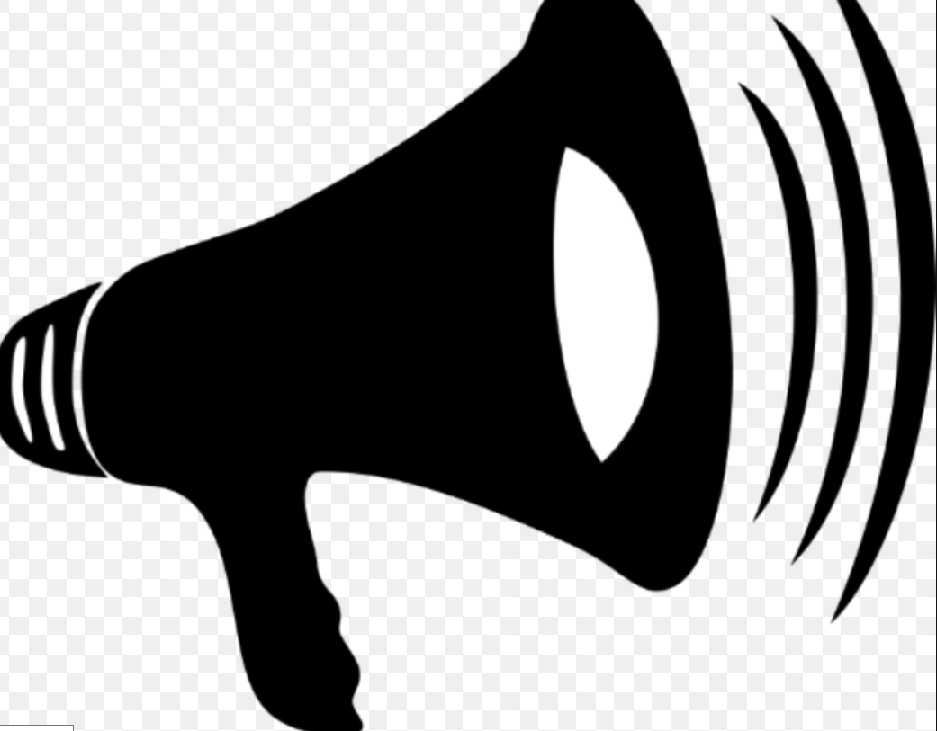

Village meeting Loudspeaker
Capacity building
{by Provincial Department of Agriculture and Rural Development}
Mini weather stations
{Mobile Network Operator}
This week, it is sunny during the day time, no rain, temperature from 21-33 degree Celcius. Farmers should weed, check and treat for rice Brown planhopper and Rice leaf folder
Advisories
Forecasts
Dien Bien
Feedbacks
Feedbacks
{District observation points}
Forecasts
Monitoring
Translation into advisories
Correspondence
{Commune PC}
{Village heads}
Use of information
{District technical working group}
{Women, men}
{Provincial Met station}
Feedbacks
Gender dialogue and sensitiveness
{District technical working group}
{Department of Agriculture and Rural Development}
{District Agri. Extension Center}
Sub-Gov Units, NGO engagement
{Commune People Committee, extension workers, village heads, Women Union, CCD}
{Provincial People Committee}
{District People Committee}
Notes:
https://www.vectorstock.com/royalty-free-vector/business-meeting-sketch-vector-2850121
https://en.wikipedia.org/wiki/Global_temperature_record
http://www.ozekisms.com/index.php?owpn=368
https://www.gettyimages.de/detail/illustration/tea-farmer-icon-flat-graphic-design-lizenfreie-illustration/490391192?adppopup=true
https://www.google.com/search?q=rice+drawing&sxsrf=ACYBGNSEO1Ytn7WU0_oJATOGi5zV-ZbVbQ:1576491829330&source=lnms&tbm=isch&sa=X&ved=2ahUKEwjZ0unb-bnmAhVK2aQKHSRDDNQQ_AUoAXoECA0QAw&biw=1368&bih=748&dpr=2#imgrc=LXPize0mVFd3zM
https://www.google.com/search?q=temperature+graph&client=firefox-b-d&sxsrf=ACYBGNSTsCN0SIL0gK5HmwQFaJGKnnIysg:1576491556307&source=lnms&tbm=isch&sa=X&ved=2ahUKEwig1NHZ-LnmAhWD_KQKHU6ZBQUQ_AUoAXoECA0QAw&biw=1368&bih=748#imgrc=UuT-xAx6VaT0_M

Slide 13




Capacity building
{Provincial Department of Agriculture and Rural Development}
New mini weather stations (1)
{Provincial Met station}
Forecasts
Advisories
SMS (1,2)
SMS+loudspeaker (3)
Correspondance + loudspeaker (4)
Collect data from observation point
Feedback
Feedback
Forecast
Monitor quality
{Mobile operator
Commune
Village leader }
Use of information
{Provincial Met station}
Translation into advisories, monitor
{Women, men}
{Provincial Met station}
{District technical working group}
Feedback
Gender reflection & dialogue (1,2)
Gender sensitiveness (3,4)
{CCD, Women Union}
{District Agri. Service Center}
Engage sub-Gov Units, NGO
{Commune People Committee, extension workers, village heads, communal women Union, CCD}
{District People Committee}
{Provincial People Committee}
Variations for different interventions (1,2,3,4)
Activities for all interventions
{Stakeholder}
Money flow
Notes:
https://www.vectorstock.com/royalty-free-vector/business-meeting-sketch-vector-2850121
https://en.wikipedia.org/wiki/Global_temperature_record
http://www.ozekisms.com/index.php?owpn=368
https://www.gettyimages.de/detail/illustration/tea-farmer-icon-flat-graphic-design-lizenfreie-illustration/490391192?adppopup=true
https://www.google.com/search?q=rice+drawing&sxsrf=ACYBGNSEO1Ytn7WU0_oJATOGi5zV-ZbVbQ:1576491829330&source=lnms&tbm=isch&sa=X&ved=2ahUKEwjZ0unb-bnmAhVK2aQKHSRDDNQQ_AUoAXoECA0QAw&biw=1368&bih=748&dpr=2#imgrc=LXPize0mVFd3zM
https://www.google.com/search?q=temperature+graph&client=firefox-b-d&sxsrf=ACYBGNSTsCN0SIL0gK5HmwQFaJGKnnIysg:1576491556307&source=lnms&tbm=isch&sa=X&ved=2ahUKEwig1NHZ-LnmAhWD_KQKHU6ZBQUQ_AUoAXoECA0QAw&biw=1368&bih=748#imgrc=UuT-xAx6VaT0_M

Slide 14

Capacity building
{Provincial Department of Agriculture and Rural Development}
New mini weather stations (1)
{Provincial Met. station}
{Mobile operator, Commune,
Village leader }
Forecasts
Advice
Paper bulletin (1,2,3,4)
SMS (1,2)
SMS+loudspeaker (3)
Correspondance + loudspeaker (4)
Feedback
Feedback
Collect data from observation point
Forecast,
Monitor quality
Translation into advice, monitor
{Provincial Met. station}
{District technical working group at
District Agri. Service Center}
Use of information
{Women, men}
Gender reflection & dialogue (1,2)
Gender sensitiveness (3,4)
{NGO, Women Union}
Activities for all interventions
Variations for different interventions (1,2,3,4)
Engage sub-Gov Units, NGO
{Commune People Committee, extension workers, village leaders, communal Women Union, NGO}
{Stakeholder}
Notes:
https://www.vectorstock.com/royalty-free-vector/business-meeting-sketch-vector-2850121
https://en.wikipedia.org/wiki/Global_temperature_record
http://www.ozekisms.com/index.php?owpn=368
https://www.gettyimages.de/detail/illustration/tea-farmer-icon-flat-graphic-design-lizenfreie-illustration/490391192?adppopup=true
https://www.google.com/search?q=rice+drawing&sxsrf=ACYBGNSEO1Ytn7WU0_oJATOGi5zV-ZbVbQ:1576491829330&source=lnms&tbm=isch&sa=X&ved=2ahUKEwjZ0unb-bnmAhVK2aQKHSRDDNQQ_AUoAXoECA0QAw&biw=1368&bih=748&dpr=2#imgrc=LXPize0mVFd3zM
https://www.google.com/search?q=temperature+graph&client=firefox-b-d&sxsrf=ACYBGNSTsCN0SIL0gK5HmwQFaJGKnnIysg:1576491556307&source=lnms&tbm=isch&sa=X&ved=2ahUKEwig1NHZ-LnmAhWD_KQKHU6ZBQUQ_AUoAXoECA0QAw&biw=1368&bih=748#imgrc=UuT-xAx6VaT0_M

Slide 15
Benefits of interventions
Agro-climate intervention
Implementation
Costs of interventions
Forecast inaccuracy risk
Low effective adoption risk
Capacity and self-reflection enhanced
Information access
Women and men
Enabling environment
Hydro-met stations
Forecasts
Translation forecasts into agro-advice
Dissemination (SMS/loud speaker)
Use
Advice
Capacity
&
Gender,M&E
Risks, uncertainty informed planning and implementation
Change gender relation (women and men)
Staff’s self farming and advice
Total Costs
Reduce excess use seeds, water, fertilizers, pesticides, harvest losses
Prepare feeds, do not release animals during cold spell
Time sharing,
free choice, decision
for women and men
Reduced inputs, losses
Increased yields (rice)
Reduced buffalo, cow
Deaths
Cleaner drinking water,
Reduced fish deaths, GHG
Additional livelihood income
Income generation
Reduced
Farmers’ health costs
Net Present
Value
Total Benefits
Discount rate
Notes:
This is the conceptual framework developed. There are four components in this framework, including
Costs, benefits, risks of implementation and discount rate
Costs: consists of hydro-met stations establishment and forecast generation, translations from forecasts into advisories, disseminate information, use of advisories and costs for cross-cutting activities
Benefits: There are different layers of benfits. First are capacity and self-reflection enhancement, improved access to information (forecasts and advisories) for both staff and farmers. It will also create enabling environment for the implementation of intervention. These benefits will lead to Risks, uncertainty informed planning, changing gender relation and improve staff capacity….
The risks, uncertainty informed planning will lead to reduction of excess use agricultural inputs and avoidance of harvest losses. It will also protect animals during cold spell. Changing gender roles lead to time sharing and equal decision making
The staff capacity (self-farming and advices) leads to income generation
Other economic benefits include: Reduced agricultural inputs, losses, impact on yield; reduced animal deaths, cleaner drinking water, reduced fished deaths, GHG, farmers’s health costs and additional livelihood income as the result of more gender equality
All those components will be used to calculate Net-Present value of interventions

Slide 16
Benefits of interventions
Agro-climate intervention
Implementation
Costs of interventions
Forecast inaccuracy risk
Low effective adoption risk
Capacity and self-reflection enhanced
Information access
Women and men
Enabling environment
Hydro-met stations
Forecasts
Translation forecasts into agro-advisories
Dissemination (SMS/loud speaker)
Use
Advisories
Capacity
&
Gender,M&E
Risks, uncertainty informed planning and implementation
Change gender relation (women and men)
Staff’s self farming and advices
Total Costs
Reduce excess use seeds, water, fertilizers, pesticides, harvest losses
Prepare feeds, do not release animals during cold spell
Time sharing,
free choice, decision
for women and men
Reduced inputs, losses
Increased yields (rice)
Reduced buffalo, cow
Deaths
Cleaner drinking water,
Reduced fish deaths, GHG
Additional livelihood income
Income generation
Reduced
Farmers’ health costs
Net Present
Value
Total Benefits
Discount rate
Notes:
This is the conceptual framework developed. There are four components in this framework, including
Costs, benefits, risks of implementation and discount rate
Costs: consists of hydro-met stations establishment and forecast generation, translations from forecasts into advisories, disseminate information, use of advisories and costs for cross-cutting activities
Benefits: There are different layers of benfits. First are capacity and self-reflection enhancement, improved access to information (forecasts and advisories) for both staff and farmers. It will also create enabling environment for the implementation of intervention. These benefits will lead to Risks, uncertainty informed planning, changing gender relation and improve staff capacity….
The risks, uncertainty informed planning will lead to reduction of excess use agricultural inputs and avoidance of harvest losses. It will also protect animals during cold spell. Changing gender roles lead to time sharing and equal decision making
The staff capacity (self-farming and advices) leads to income generation
Other economic benefits include: Reduced agricultural inputs, losses, impact on yield; reduced animal deaths, cleaner drinking water, reduced fished deaths, GHG, farmers’s health costs and additional livelihood income as the result of more gender equality
All those components will be used to calculate Net-Present value of interventions

Slide 17
100%
Saturation
Adoption rate
Imitation - disadoption
Innovation
0%
Year

